Slide 1
Content
Unsupervised learning
K-means clustering
Hierarichal clustering
Anomaly detection
Gaussian distribution
Box and Whisker plot
PCA
Recommendation system
Collaborative filtering
Content based filtering

Slide 2
What is unsupervised learning?
uses machine learning algorithms to analyze and cluster unlabeled datasets.
These algorithms discover hidden patterns or data groupings without the need for human intervention.
The data have no target attribute.
We want to explore the data to find some intrinsic structures in them.

Slide 3
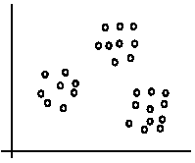
Clustering
Clustering is a technique for finding similarity groups in data, called clusters. i.e.,
it groups data instances that are similar to (near) each other in one cluster and data instances that are very different (far away) from each other into different clusters.
Notes:
Clustering is often called an unsupervised learning task as no class values denoting an a priori grouping of the data instances are given, which is the case in supervised learning.
Due to historical reasons, clustering is often considered synonymous with unsupervised learning.
In fact, association rule mining is also unsupervised

Slide 4
What is clustering for?
Let us see some real-life examples
Example 1: groups people of similar sizes together to make “small”, “medium” and “large” T-Shirts.
Tailor-made for each person: too expensive
One-size-fits-all: does not fit all.
Example 2: In marketing, segment customers according to their similarities
To do targeted marketing.

Slide 5
What is clustering for?
Example 3: Given a collection of text documents, we want to organize them according to their content similarities,
To produce a topic hierarchy
Notes:
In fact, clustering is one of the most utilized data mining techniques.
It has a long history, and used in almost every field, e.g., medicine, psychology, botany, sociology, biology, archeology, marketing, insurance, libraries, etc.
In recent years, due to the rapid increase of online documents, text clustering becomes important.

Slide 6
Aspects of clustering
A clustering algorithm
Partitional clustering
K-mean clustering
Hierarchical clustering
A distance (similarity, or dissimilarity) function
Clustering quality
Inter-clusters distance ⇒ maximized
Intra-clusters distance ⇒ minimized
The quality of a clustering result depends on the algorithm, the distance function, and the application.

Slide 7
K-means clustering
K-means is a partitional clustering algorithm
Let the set of data points (or instances) D be {x₁, x₂, …, x_{n}}, where x_{i} = (x_{i1}, x_{i2}, …, x_{ir}) is a vector in a real-valued space X ⊆ R^{r}, and r is the number of attributes (dimensions) in the data.
The k-means algorithm partitions the given data into k clusters.
Each cluster has a cluster center, called centroid.
k is specified by the user

Slide 8
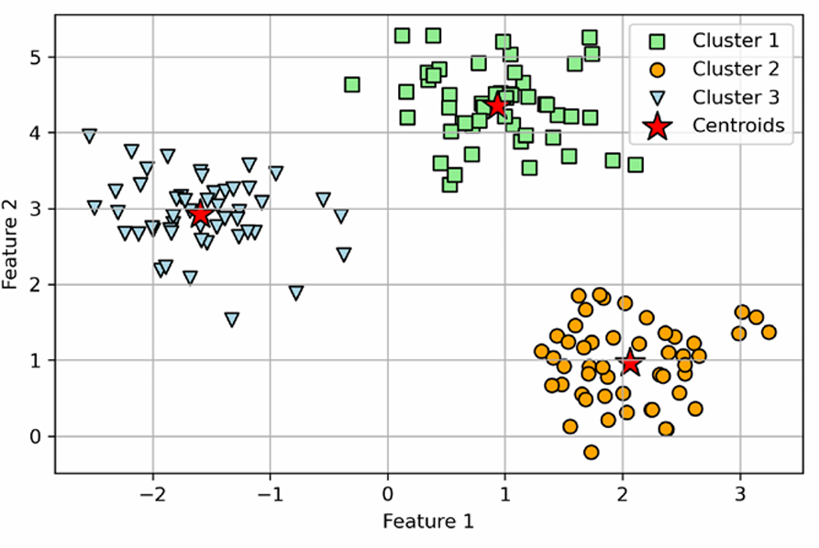
K-means clustering
In Figure, you can see that k-means placed the three centroids at the center of each sphere, which looks like a reasonable grouping given this dataset

Slide 9
K-means algorithm
Given k, the k-means algorithm works as follows:
Randomly choose k data points (seeds) to be the initial centroids, cluster centers
Assign each data point to the closest centroid
Re-compute the centroids using the current cluster memberships.
If a convergence criterion is not met, go to 2).

Slide 10
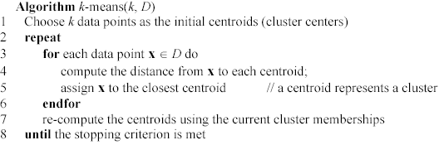
K-means algorithm

Slide 11
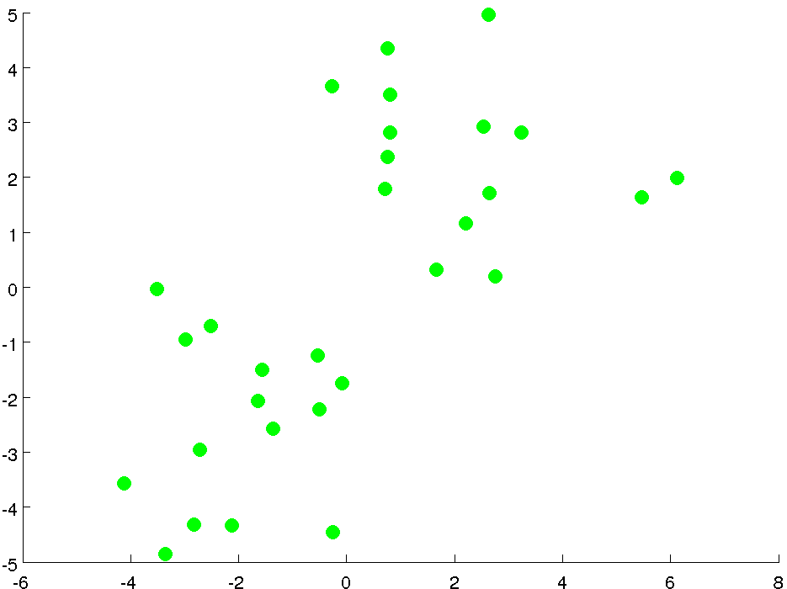

Slide 12
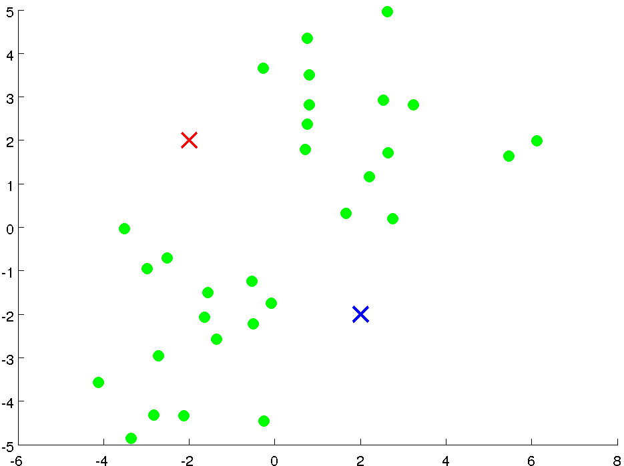
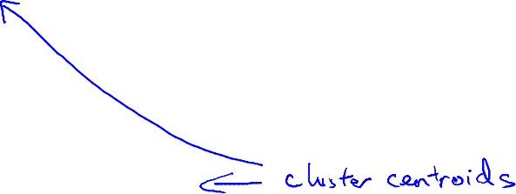

Slide 13
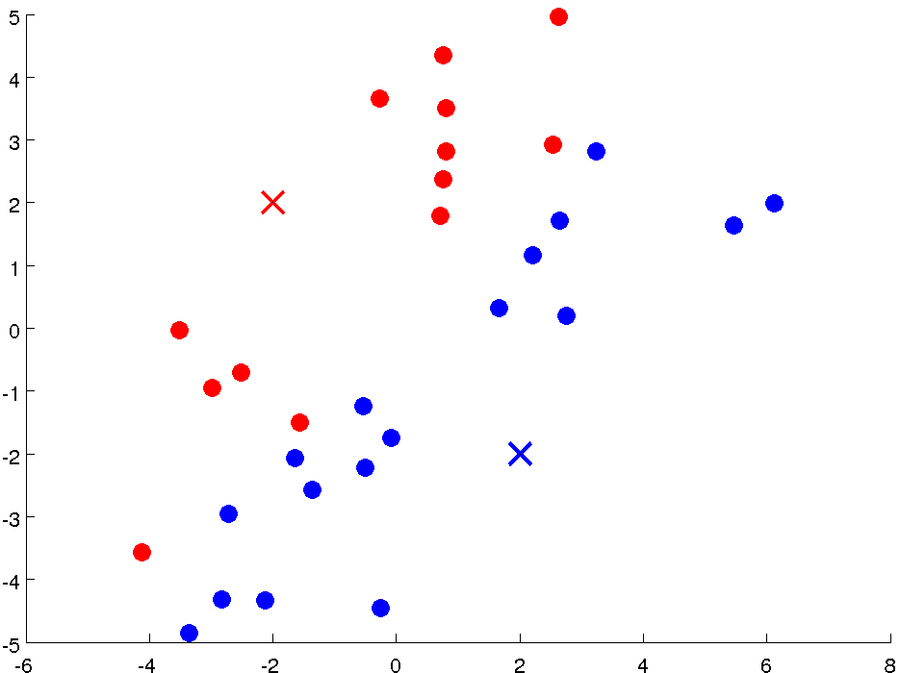

Slide 14
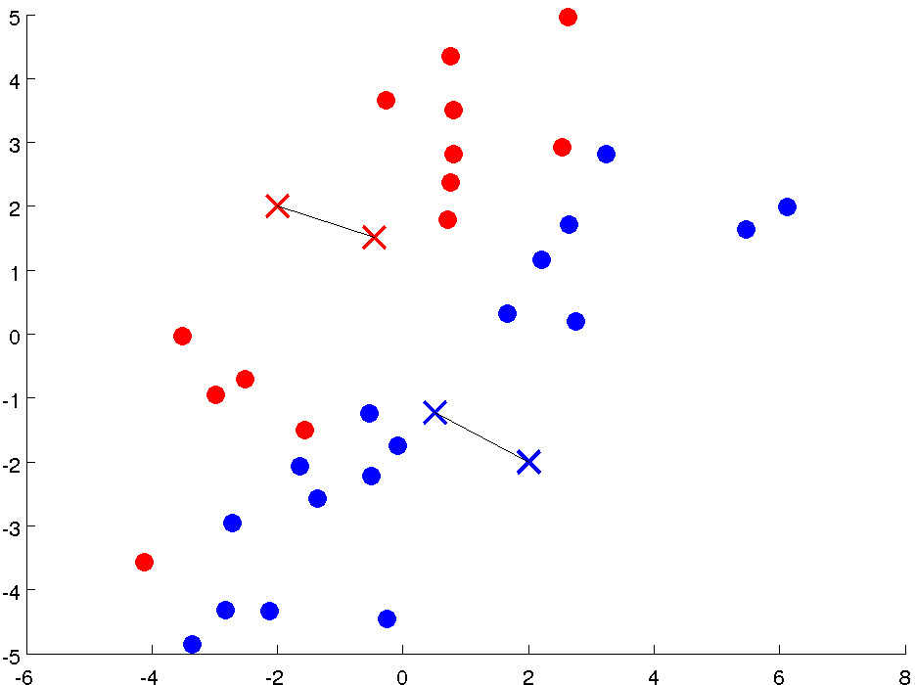
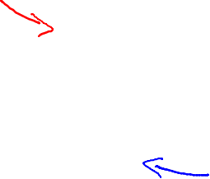

Slide 15
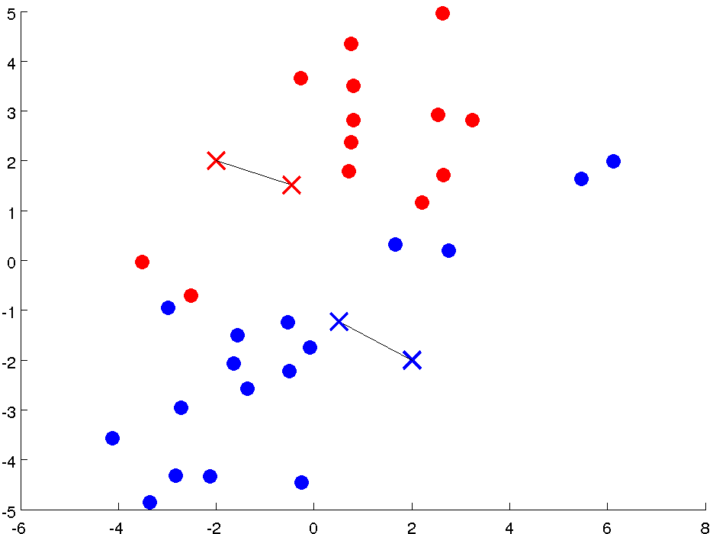

Slide 16
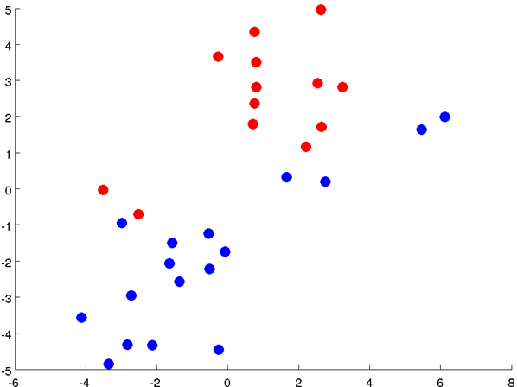

Slide 17
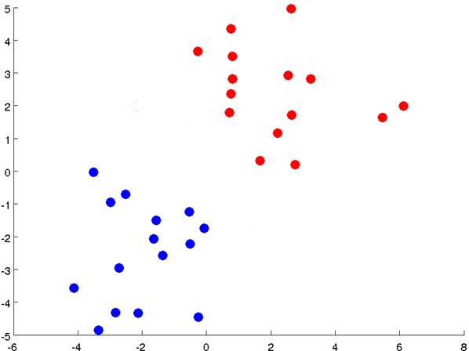

Slide 18
Notes:
Get rid of the legacy points

Slide 19
Notes:
Get rid of the legacy points

Slide 20
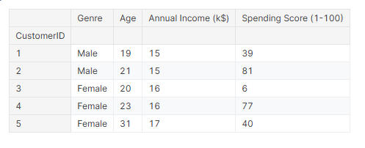
K-means example
Notes:
In the Mall Customer Segmentation Dataset, the Spending Score represents a metric that indicates the spending behavior of a customer in the mall. It is a score assigned to each customer on a scale from 1 to 100, where:
1 represents the lowest spending behavior, implying that the customer spends minimally.
100 represents the highest spending behavior, suggesting that the customer spends generously.

Slide 21
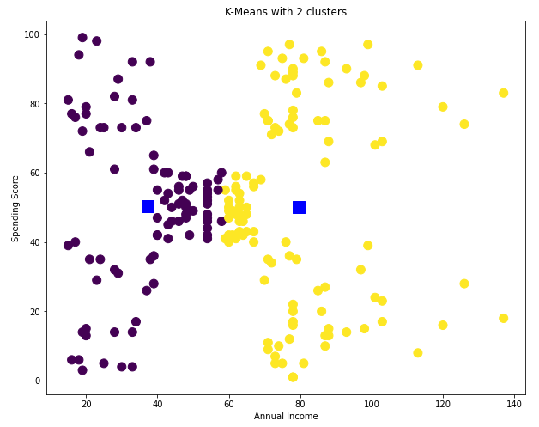
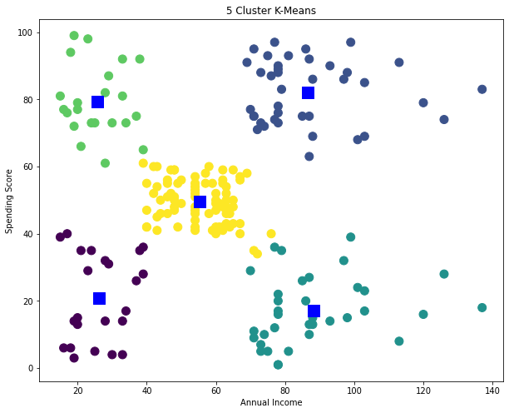
K-means example
Notes:
Get rid of the legacy points

Slide 22
Stopping/ convergence criterion
no (or minimum) re-assignments of data points to different clusters,
no (or minimum) change of centroids, or
minimum decrease in the sum of squared error (SSE),
C_{i} is the jth cluster, m_{j} is the centroid of cluster C_{j} (the mean vector of all the data points in C_{j}), and dist(x, m_{j}) is the distance between data point x and centroid m_{j}.

Slide 23
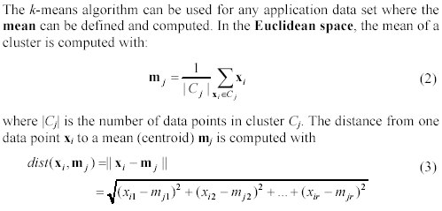
An example distance function

Slide 24
Strengths of k-means
Strengths:
Simple: easy to understand and to implement
Efficient: Time complexity: O(tkn),
where n is the number of data points,
k is the number of clusters, and
t is the number of iterations.
Since both k and t are small. k-means is considered a linear algorithm.

Slide 25
Weaknesses
The algorithm is only applicable if the mean is defined.
For categorical data, k-mode - the centroid is represented by most frequent values.
The user needs to specify k.
The algorithm is sensitive to outliers
Outliers are data points that are very far away from other data points.
Outliers could be errors in the data recording or some special data points with very different values.

Slide 26
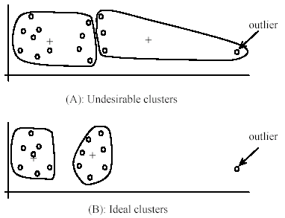
Weaknesses of k-means: Problems with outliers
Notes:
Weaknesses of k-means: to deal with outliers:
One method is to remove some data points in the clustering process that are much further away from the centroids than other data points.
Another method is to perform random sampling. Since in sampling we only choose a small subset of the data points, the chance of selecting an outlier is very small.

Slide 27
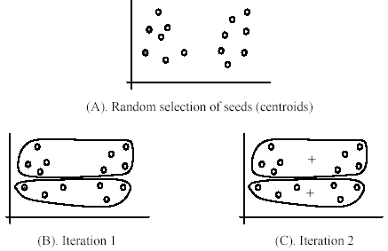
Weaknesses of k-means: sensitive to initial seeds

Slide 28
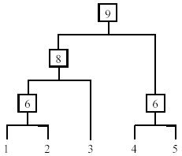
Hierarchical clustering
Produce a nested sequence of clusters, a tree, also called Dendrogram.

Slide 29
Types of hierarchical clustering
Agglomerative (bottom up) clustering: It builds the dendrogram (tree) from the bottom level, and
merges the most similar (or nearest) pair of clusters
stops when all the data points are merged into a single cluster (i.e., the root cluster).
Divisive (top down) clustering: It starts with all data points in one cluster, the root.
Splits the root into a set of child clusters. Each child cluster is recursively divided further
stops when only singleton clusters of individual data points remain, i.e., each cluster with only a single point

Slide 30
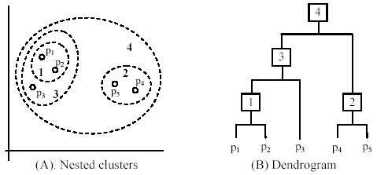
Types of hierarchical clustering

Slide 31
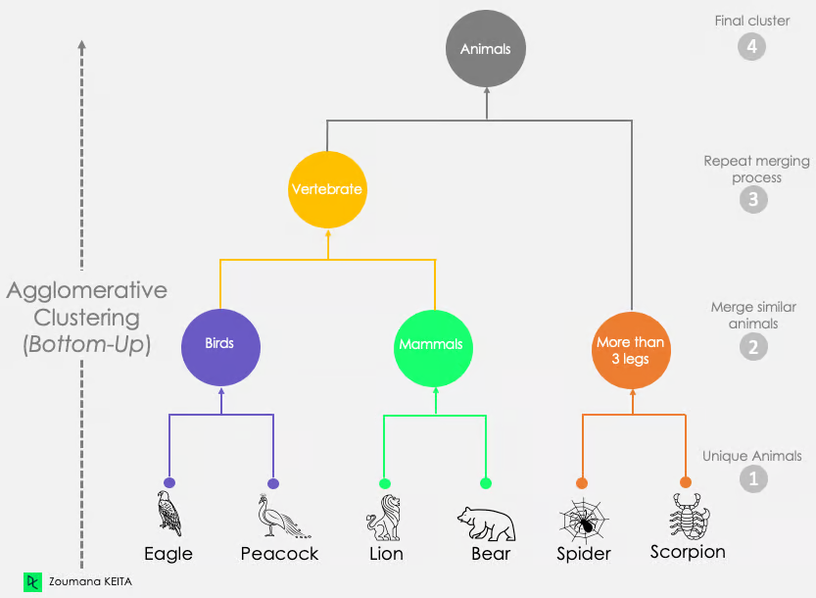
Hierarchical clustering example
Notes:
https://www.datacamp.com/tutorial/introduction-hierarchical-clustering-python

Slide 32
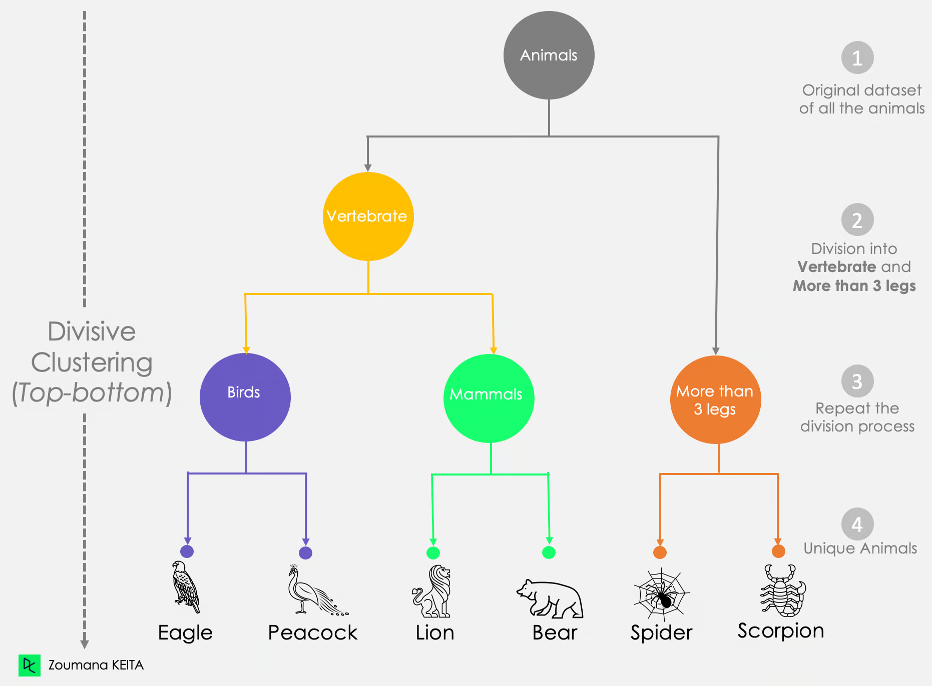
Hierarchical clustering example

Slide 33
Measuring the distance of two clusters
A few ways to measure distances of two clusters.
Results in different variations of the algorithm.
Single link
Complete link
Average link
Centroids

Slide 34
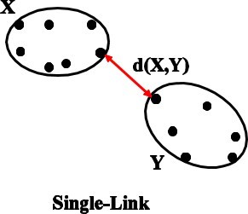
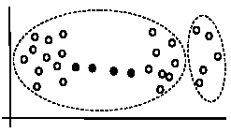
Single link method
The distance between two clusters is the distance between two closest data points in the two clusters, one data point from each cluster.
It can find arbitrarily shaped clusters, but
It may cause the undesirable “chain effect” by noisy points

Slide 35
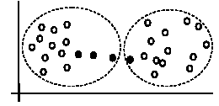
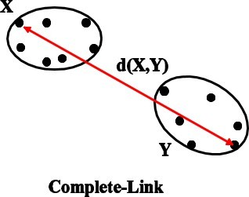
Complete link method
The distance between two clusters is the distance of two furthest data points in the two clusters.
It is sensitive to outliers because they are far away

Slide 36
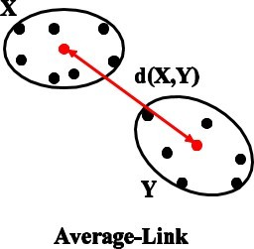
Average link
Clusters are merged based on the average distance between all pairs of points in the two clusters.

Slide 37
Centroid methods
Centroid method: In this method, the distance between two clusters is the distance between their centroids

Slide 38
Example: Single Link Clustering
12
11
10
9
8
7
6
5
4
3
2 C D
1
I
G H J
K
F
L
M
E
N O P
Q R S
T
A B
1 2 3 4 5 6 7 8 9 10 11 12
A B C D E F G H J I K L M O N P Q S R T

Slide 39
Example: Single Link Clustering
12
11
10
9
8
7
6
5
4
3
2 C D
1
I
G H J
K
F
L
M
E
N O P
Q R S
T
1
A B
1 2 3 4 5 6 7 8 9 10 11 12
A B C D E F G H J I K L M O N P Q S R T

Slide 40
Example: Single Link Clustering
Start example Skip example
12
11
10
9
8
7
6
5
4
3
2 C D
1
I
G H J
K
F
L
M
E
N O P
Q R S
T
1
A B
1 2 3 4 5 6 7 8 9 10 11 12
A B C D E F G H J I K L M O N P Q S R T

Slide 41
Example: Single Link Clustering
12
11
10
9
8
7
6
5
4
3
2 C D
1
I
G H J
K
F
L
M
E
N O P
Q R S
T
1
A B
1 2 3 4 5 6 7 8 9 10 11 12
A B C D E F G H J I K L M O N P Q S R T

Slide 42
Example: Single Link Clustering
12
11
10
9
8
7
6
5
4
3
2 C D
1
I
G H J
K
F
L
M
E
N O P
Q R S
T
1
A B
1 2 3 4 5 6 7 8 9 10 11 12
A B C D E F G H J I K L M O N P Q S R T

Slide 43
Example: Single Link Clustering
Start example Skip example
12
11
10
9
8
7
6
5
4
3
2 C D
1
I
G H J
K
F
L
M
E
N O P
Q R S
T
1
A B
1 2 3 4 5 6 7 8 9 10 11 12
A B C D E F G H J I K L M O N P Q S R T

Slide 44
Example: Single Link Clustering
Start example Skip example
12
11
10
9
8
7
6
5
4
3
2 C D
1
I
G H J
K
F
L
M
E
N O P
Q R S
T
1
A B
1 2 3 4 5 6 7 8 9 10 11 12
A B C D E F G H J I K L M O N P Q S R T

Slide 45
Example: Single Link Clustering
Start example Skip example
12
11
10
9
8
7
6
5
4
3
2 C D
1
I
G H J
K
F
L
M
E
N O P
Q R S
T
1
A B
1 2 3 4 5 6 7 8 9 10 11 12
A B C D E F G H J I K L M O N P Q S R T

Slide 46
Example: Single Link Clustering
Start example Skip example
12
11
10
9
8
7
6
5
4
3
2 C D
1
I
G H J
K
F
L
M
E
N O P
Q R S
T
1
A B
1 2 3 4 5 6 7 8 9 10 11 12
A B C D E F G H J I K L M O N P Q S R T

Slide 47
Example: Single Link Clustering
Start example Skip example
12
11
10
9
8
7
6
5
4
3
2 C D
1
I
G H J
K
F
L
M
E
N O P
Q R S
T
1
A B
1 2 3 4 5 6 7 8 9 10 11 12
A B C D E F G H J I K L M O N P Q S R T

Slide 48
Example: Single Link Clustering
Start example Skip example
12
11
10
9
8
7
6
5
4
3
2 C D
1
I
G H J
K
F
L
M
E
N O P
Q R S
T
1
A B
1 2 3 4 5 6 7 8 9 10 11 12
A B C D E F G H J I K L M O N P Q S R T

Slide 49
Example: Single Link Clustering
Start example Skip example
12
11
10
9
8
7
6
5
4
3
2 C D
1
I
G H J
K
F
L
M
E
N O P
Q R S
T
1
A B
1 2 3 4 5 6 7 8 9 10 11 12
A B C D E F G H J I K L M O N P Q S R T

Slide 50
Example: Single Link Clustering
12
11
10
9
8
7
6
5
4
3
2 C D
1
I
G H J
K
F
L
M
E
N O P
Q R S
T
1
A B
1 2 3 4 5 6 7 8 9 10 11 12
A B C D E F G H J I K L M O N P Q S R T

Slide 51
Example: Single Link Clustering
Start example Skip example
12
11
10
9
8
7
6
5
4
3
2 C D
1
I
G H J
K
F
L
M
E
N O P
Q R S
T
1
A B
1 2 3 4 5 6 7 8 9 10 11 12
A B C D E F G H J I K L M O N P Q S R T

Slide 52
Example: Single Link Clustering
Start example Skip example
12
11
10
9
8
7
6
5
4
3
2 C D
1
I
G H J
K
F
L
M
E
N O P
Q R S
T
1
A B
1 2 3 4 5 6 7 8 9 10 11 12
A B C D E F G H J I K L M O N P Q S R T

Slide 53
Example: Single Link Clustering
Start example Skip example
12
11
10
9
8
7
6
5
4
3
2 C D
1
I
G H J
K
F
L
M
E
N O P
Q R S
T
1
A B
1 2 3 4 5 6 7 8 9 10 11 12
A B C D E F G H J I K L M O N P Q S R T

Slide 54
Example: Single Link Clustering
12
11
10
9
8
7
6
5
4
3
2 C D
1
I
G H J
K
F
L
M
E
N O P
Q R S
2
T
1
A B
1 2 3 4 5 6 7 8 9 10 11 12
A B C D E F G H J I K L M O N P Q S R T
116

Slide 55
Example: Single Link Clustering
12
11
10
9
8
7
6
5
4
3
2 C D
1
I
G H J
K
F
L
M
E
N O P
Q R S
2
T
1
A B
1 2 3 4 5 6 7 8 9 10 11 12
A B C D E F G H J I K L M O N P Q S R T

Slide 56
Example: Single Link Clustering
12
11
10
9
8
7
6
5
4
3
2 C D
1
I
G H J
K
F
L
M
3
E
N O P
Q R S
2
T
1
A B
1 2 3 4 5 6 7 8 9 10 11 12
A B C D E F G H J I K L M O N P Q S R T

Slide 57
Example: Single Link Clustering
12
11
10
9
8
7
6
5
4
3
2 C D
1
12
11
10
9
8
7
6
5
4
3
2 C D
1
I
I
K
G H J
K
G H J
F
F
L
L
4
3
M
3
M
E
E
N O P
N O P
2
Q R S
2
Q R S
T
T
1
1
A B
A B
A B C D E F G H J I K L M O N P Q S R T
1 2 3 4 5 6 7 8 9 10 11 12
A B C D E F G H J I K L M O N P Q S R T
1 2 3 4 5 6 7 8 9 10 11 12

Slide 58
Example: Single Link Clustering
12
11
10
9
8
7
6
5
4
3
2 C D
1
I
G H J
K
F
L
4
M
3
E
N O P
Q R S
2
T
1
A B
1 2 3 4 5 6 7 8 9 10 11 12
A B C D E F G H J I K L M O N P Q S R T

Slide 59
Example: Single Link Clustering
Start example Skip example
12
11
10
9
8
7
6
5
4
3
2 C D
1
I
G H J
K
F
L
4
M
3
E
N O P
Q R S
2
T
1
A B
1 2 3 4 5 6 7 8 9 10 11 12
A B C D E F G H J I K L M O N P Q S R T

Slide 60
Example Complete Link Clustering
12
11
10
9
8
7
6
5
4
3
2 C D
1
I
G H J
K
F
L
M
E
N O P
Q R S
T
A B
1 2 3 4 5 6 7 8 9 10 11 12
A B C D E F G H J I K L M O N Q P S R T

Slide 61
Example Complete Link Clustering
12
11
10
9
8
7
6
5
4
3
2 C D
1
I
G H J
K
F
L
M
E
N O P
Q R S
T
A B
1
1 2 3 4 5 6 7 8 9 10 11 12
A B C D E F G H J I K L M O N Q P S R T

Slide 62
Example Complete Link Clustering
12
11
10
9
8
7
6
5
4
3
2 C D
1
I
G H J
K
F
L
M
E
N O P
Q R S
T
A B
1
1 2 3 4 5 6 7 8 9 10 11 12
A B C D E F G H J I K L M O N Q P S R T

Slide 63
Example Complete Link Clustering
12
11
10
9
8
7
6
5
4
3
2 C D
1
I
G H J
K
F
L
M
E
N O P
Q R S
T
A B
1
1 2 3 4 5 6 7 8 9 10 11 12
A B C D E F G H J I K L M O N Q P S R T

Slide 64
Example Complete Link Clustering
12
11
10
9
8
7
6
5
4
3
2 C D
1
I
G H J
K
F
L
M
E
N O P
Q R S
T
2
1
A B
1 2 3 4 5 6 7 8 9 10 11 12
A B C D E F G H J I K L M O N Q P S R T

Slide 65
Example Complete Link Clustering
12
11
10
9
8
7
6
5
4
3
2 C D
1
I
G H J
K
F
L
M
E
N O P
Q R S
T
3
2
1
A B
1 2 3 4 5 6 7 8 9 10 11 12
A B C D E F G H J I K L M O N Q P S R T
117

Slide 66
Example Complete Link Clustering
Start example Skip example
12
11
10
9
8
7
6
5
4
3
2 C D
1
I
G H J
K
F
L
M
E
N O P
Q R S
4
3
2
1
T
A B
1 2 3 4 5 6 7 8 9 10 11 12
A B C D E F G H J I K L M O N Q P S R T

Slide 67
Example Complete Link Clustering
12
11
10
9
8
7
6
5
4
3
2 C D
1
I
G H J
K
14
F
L
8
7
6
5
4
3
2
1
M
E
N O P
Q R S
T
A B
1 2 3 4 5 6 7 8 9 10 11 12
A B C D E F G H J I K L M O N Q P S R T

Slide 68
Example Complete Link Clustering
12
11
10
9
8
7
6
5
4
3
2 C D
1
17
I
G H J
K
14
F
L
8
7
6
5
4
3
2
1
M
E
N O P
Q R S
T
A B
1 2 3 4 5 6 7 8 9 10 11 12
A B C D E F G H J I K L M O N Q P S R T

Slide 69
Example Average Link Clustering
Start example Skip example
12
11
10
9
8
7
6
5
4
3
2 C D
1
I
G H J
K
F
L
M
E
N O P
Q R S
T
A B
1 2 3 4 5 6 7 8 9 10 11 12
A B C D E F G H J I K L M O N P Q S R T

Slide 70


Example Average Link Clustering
Start example Skip example
Introduction to Data Mining
Arthur Zimek
12
11
10
9
8
7
6
5
4
3
2 C D
1
I
G H J
K
Introduction
Clustering Introduction Partitional Clustering
Density-based Clustering
F
L
M
Hierarchical Clustering
E
N O P
Outlier Detection
On Evaluation in Unsupervised Data Mining
Challenges in High-dimensional Data
Clustering
High-dimensional Data
Outlier Detection in High-dimensional Data
References
Q R S
T
A B
1
1 2 3 4 5 6 7 8 9 10 11 12
A B C D E F G H J I K L M O N P Q S R T
118

Slide 71
Example Average Link Clustering
Start example Skip example
Introduction to Data Mining
Arthur Zimek
12
11
10
9
8
7
6
5
4
3
2 C D
1
I
G H J
K
Introduction
Clustering Introduction Partitional Clustering
Density-based Clustering
F
L
M
Hierarchical Clustering
E
N O P
Outlier Detection
On Evaluation in Unsupervised Data Mining
Challenges in High-dimensional Data
Clustering
High-dimensional Data
Outlier Detection in High-dimensional Data
References
Q R S
T
A B
1
1 2 3 4 5 6 7 8 9 10 11 12
A B C D E F G H J I K L M O N P Q S R T
118

Slide 72
Example Average Link Clustering
Start example Skip example
Introduction to Data Mining
Arthur Zimek
12
11
10
9
8
7
6
5
4
3
2 C D
1
I
G H J
K
Introduction
Clustering Introduction Partitional Clustering
Density-based Clustering
F
L
M
Hierarchical Clustering
E
N O P
Outlier Detection
On Evaluation in Unsupervised Data Mining
Challenges in High-dimensional Data
Clustering
High-dimensional Data
Outlier Detection in High-dimensional Data
References
Q R S
T
A B
1
1 2 3 4 5 6 7 8 9 10 11 12
A B C D E F G H J I K L M O N P Q S R T
118

Slide 73
Example Average Link Clustering
Start example Skip example
Introduction to Data Mining
Arthur Zimek
12
11
10
9
8
7
6
5
4
3
2 C D
1
I
G H J
K
Introduction
Clustering Introduction Partitional Clustering
Density-based Clustering
F
L
M
Hierarchical Clustering
E
N O P
Outlier Detection
On Evaluation in Unsupervised Data Mining
Challenges in High-dimensional Data
Clustering
High-dimensional Data
Outlier Detection in High-dimensional Data
References
Q R S
T
A B
1
1 2 3 4 5 6 7 8 9 10 11 12
A B C D E F G H J I K L M O N P Q S R T
118

Slide 74
Example Average Link Clustering
Start example Skip example
Introduction to Data Mining
Arthur Zimek
12
11
10
9
8
7
6
5
4
3
2 C D
1
I
G H J
K
Introduction
Clustering Introduction Partitional Clustering
Density-based Clustering
F
L
M
Hierarchical Clustering
E
N O P
Outlier Detection
On Evaluation in Unsupervised Data Mining
Challenges in High-dimensional Data
Clustering
High-dimensional Data
Outlier Detection in High-dimensional Data
References
Q R S
T
A B
1
1 2 3 4 5 6 7 8 9 10 11 12
A B C D E F G H J I K L M O N P Q S R T
118

Slide 75
Example Average Link Clustering
Start example Skip example
Introduction to Data Mining
Arthur Zimek
12
11
10
9
8
7
6
5
4
3
2 C D
1
I
G H J
K
Introduction
Clustering Introduction Partitional Clustering
Density-based Clustering
F
L
M
Hierarchical Clustering
E
N O P
Outlier Detection
On Evaluation in Unsupervised Data Mining
Challenges in High-dimensional Data
Clustering
High-dimensional Data
Outlier Detection in High-dimensional Data
References
Q R S
T
A B
1
1 2 3 4 5 6 7 8 9 10 11 12
A B C D E F G H J I K L M O N P Q S R T
118

Slide 76
Example Average Link Clustering
Start example Skip example
Introduction to Data Mining
Arthur Zimek
12
11
10
9
8
7
6
5
4
3
2 C D
1
I
G H J
K
Introduction
Clustering Introduction Partitional Clustering
Density-based Clustering
F
L
M
Hierarchical Clustering
E
N O P
Outlier Detection
On Evaluation in Unsupervised Data Mining
Challenges in High-dimensional Data
Clustering
High-dimensional Data
Outlier Detection in High-dimensional Data
References
Q R S
T
A B
1
1 2 3 4 5 6 7 8 9 10 11 12
A B C D E F G H J I K L M O N P Q S R T
118

Slide 77
Example Average Link Clustering
12
11
10
9
8
7
6
5
4
3
2 C D
1
I
G H J
K
F
L
M
E
N O P
Q R S
T
A B
1
1 2 3 4 5 6 7 8 9 10 11 12
A B C D E F G H J I K L M O N P Q S R T

Slide 78
Example Average Link Clustering
Start example Skip example
Introduction to Data Mining
Arthur Zimek
12
11
10
9
8
7
6
5
4
3
2 C D
1 A B
1.5
G H J
I
K
Introduction
Clustering Introduction Partitional Clustering
Density-based Clustering
F
L
M
Hierarchical Clustering
E
N O P
Outlier Detection
On Evaluation in Unsupervised Data Mining
Challenges in High-dimensional Data
Q R S
T
1.5
1
Clustering
High-dimensional Data
Outlier Detection in High-dimensional Data
References
1 2 3 4 5 6 7 8 9 10 11 12
A B C D E F G H J I K L M O N P Q S R T
118

Slide 79
Example Average Link Clustering
Start example Skip example
Introduction to Data Mining
Arthur Zimek
12
11
10
9
8
7
6
5
4
3
2 C D
1
1.5
G H J
I
K
Introduction
Clustering Introduction Partitional Clustering
Density-based Clustering
F
L
M
Hierarchical Clustering
E
N O P
Outlier Detection
On Evaluation in Unsupervised Data Mining
Challenges in High-dimensional Data
Q R S
T
A B
1
Clustering
High-dimensional Data
Outlier Detection in High-dimensional Data
References
1 2 3 4 5 6 7 8 9 10 11 12
A B C D E F G H J I K L M O N P Q S R T
118

Slide 80
Example Average Link Clustering
Start example Skip example
Introduction to Data Mining
Arthur Zimek
12
11
10
9
8
7
6
5
4
3
2 C D
1
I
G H J
K
Introduction
Clustering Introduction Partitional Clustering
Density-based Clustering
F
L
M
Hierarchical Clustering
E
N O P
Outlier Detection
On Evaluation in Unsupervised Data Mining
Challenges in High-dimensional Data
Clustering
High-dimensional Data
Outlier Detection in High-dimensional Data
References
Q R S
T
A B
1
1 2 3 4 5 6 7 8 9 10 11 12
A B C D E F G H J I K L M O N P Q S R T
118

Slide 81
Example Average Link Clustering
Start example Skip example
Introduction to Data Mining
Arthur Zimek
12
11
10
9
8
7
6
5
4
3
2 C D
1
2.16 I
G H J
K
Introduction
Clustering Introduction Partitional Clustering
Density-based Clustering
F
L
2 M
Hierarchical Clustering
E
N O P
Outlier Detection
On Evaluation in Unsupervised Data Mining
Challenges in High-dimensional Data
Clustering
High-dimensional Data
Outlier Detection in High-dimensional Data
References
Q R S
T 2
A B
1
1 2 3 4 5 6 7 8 9 10 11 12
A B C D E F G H J I K L M O N P Q S R T
118

Slide 82
Example Average Link Clustering
12
11
10
9
8
7
6
5
4
3
2 C D
1
2.16 I
G H J
K
F
L
M
E
N O P
Q R S
T 2
2
1
A B
1 2 3 4 5 6 7 8 9 10 11 12
A B C D E F G H J I K L M O N P Q S R T

Slide 83
Example Average Link Clustering
Start example Skip example
Introduction to Data Mining
Arthur Zimek
12
11
10
9
8
7
6
5
4
3
2 C D
1
2.16 I
G H J
K
Introduction
Clustering Introduction Partitional Clustering
Density-based Clustering
F
L
M
Hierarchical Clustering
E
N O P
Outlier Detection
On Evaluation in Unsupervised Data Mining
Challenges in High-dimensional Data
Clustering
High-dimensional Data
Outlier Detection in High-dimensional Data
References
Q R S
T
2
1
A B
1 2 3 4 5 6 7 8 9 10 11 12
A B C D E F G H J I K L M O N P Q S R T
118

Slide 84
Example Average Link Clustering
Start example Skip example
Introduction to Data Mining
Arthur Zimek
12
11
10
9
8
7
6
5
4
3
2 C D
1
2.16 I
G H J
K
Introduction
Clustering Introduction Partitional Clustering
Density-based Clustering
F
L
M
Hierarchical Clustering
E
N O P
Outlier Detection
On Evaluation in Unsupervised Data Mining
Challenges in High-dimensional Data
Clustering
High-dimensional Data
Outlier Detection in High-dimensional Data
References
Q R S
2.125 T
2
1
A B
1 2 3 4 5 6 7 8 9 10 11 12
A B C D E F G H J I K L M O N P Q S R T
118

Slide 85
Example Average Link Clustering
Start example Skip example
Introduction to Data Mining
Arthur Zimek
12
11
10
9
8
7
6
5
4
3
2 C D
1
2.16 I
G H J
K
Introduction
Clustering Introduction Partitional Clustering
Density-based Clustering
F
L
M
Hierarchical Clustering
E
N O P
Outlier Detection
On Evaluation in Unsupervised Data Mining
Challenges in High-dimensional Data
Clustering
High-dimensional Data
Outlier Detection in High-dimensional Data
References
Q R S
T
2
1
A B
1 2 3 4 5 6 7 8 9 10 11 12
A B C D E F G H J I K L M O N P Q S R T
118

Slide 86
Example Average Link Clustering
Start example Skip example
Introduction to Data Mining
Arthur Zimek
12
11
10
9
8
7
6
5
4
3
2 C D
1
I
G H J
K
Introduction
Clustering Introduction Partitional Clustering
Density-based Clustering
F
L
M
Hierarchical Clustering
E
N O P
Outlier Detection
On Evaluation in Unsupervised Data Mining
Challenges in High-dimensional Data
Clustering
High-dimensional Data
Outlier Detection in High-dimensional Data
References
Q R S
T
2
1
A B
1 2 3 4 5 6 7 8 9 10 11 12
A B C D E F G H J I K L M O N P Q S R T
118

Slide 87
Example Average Link Clustering
Start example Skip example
Introduction to Data Mining
Arthur Zimek
12
11
10
9
8
7
6
5
4
3
2 C D
1
I
3.6
4
G H J
K
Introduction
Clustering Introduction Partitional Clustering
Density-based Clustering
F
L
5.0
5.8
M
Hierarchical Clustering
E
N O P
Outlier Detection
On Evaluation in Unsupervised Data Mining
Challenges in High-dimensional Data
Clustering
High-dimensional Data
Outlier Detection in High-dimensional Data
References
Q R S
5.0
T
2
1
A B
1 2 3 4 5 6 7 8 9 10 11 12
A B C D E F G H J I K L M O N P Q S R T
118

Slide 88
Example Average Link Clustering
Start example Skip example
Introduction to Data Mining
Arthur Zimek
12
11
10
9
8
7
6
5
4
3
2 C D
1
I
G H J
K
Introduction
Clustering Introduction Partitional Clustering
Density-based Clustering
F
L
5.0
M
Hierarchical Clustering
E
N O P
Outlier Detection
On Evaluation in Unsupervised Data Mining
Challenges in High-dimensional Data
Clustering
High-dimensional Data
Outlier Detection in High-dimensional Data
References
Q R S
4
3
2
1
5.0
T
A B
1 2 3 4 5 6 7 8 9 10 11 12
A B C D E F G H J I K L M O N P Q S R T
118

Slide 89
Example Average Link Clustering
Start example Skip example
Introduction to Data Mining
Arthur Zimek
12
11
10
9
8
7
6
5
4
3
2 C D
1
I
6.66
G H J
K
Introduction
Clustering Introduction Partitional Clustering
Density-based Clustering
F
L
5.0
6.33
M
Hierarchical Clustering
E
N O P
Outlier Detection
On Evaluation in Unsupervised Data Mining
Challenges in High-dimensional Data
Clustering
High-dimensional Data
Outlier Detection in High-dimensional Data
References
Q R S
4
3
2
1
5.0
T
A B
1 2 3 4 5 6 7 8 9 10 11 12
A B C D E F G H J I K L M O N P Q S R T
118

Slide 90
Example Average Link Clustering
Start example Skip example
Introduction to Data Mining
Arthur Zimek
12
11
10
9
8
7
6
5
4
3
2 C D
1
I
6.66
G H J
K
Introduction
Clustering Introduction Partitional Clustering
Density-based Clustering
F
L
5.0
M
Hierarchical Clustering
E
N O P
Outlier Detection
On Evaluation in Unsupervised Data Mining
Challenges in High-dimensional Data
Clustering
High-dimensional Data
Outlier Detection in High-dimensional Data
References
Q R S
4
3
2
1
T
A B
1 2 3 4 5 6 7 8 9 10 11 12
A B C D E F G H J I K L M O N P Q S R T
118

Slide 91
Example Average Link Clustering
Start example Skip example
Introduction to Data Mining
Arthur Zimek
12
11
10
9
8
7
6
5
4
3
2 C D
1
I
6.66
G H J
K
Introduction
Clustering Introduction Partitional Clustering
Density-based Clustering
F
L
5.0
9.33
M
Hierarchical Clustering
E
5
4
3
2
1
N O P
Outlier Detection
On Evaluation in Unsupervised Data Mining
Challenges in High-dimensional Data
Clustering
High-dimensional Data
Outlier Detection in High-dimensional Data
References
Q R S
T
A B
1 2 3 4 5 6 7 8 9 10 11 12
A B C D E F G H J I K L M O N P Q S R T
118

Slide 92
Example Average Link Clustering
Start example Skip example
Introduction to Data Mining
Arthur Zimek
12
11
10
9
8
7
6
5
4
3
2 C D
1
I
G H J
K
Introduction
Clustering Introduction Partitional Clustering
Density-based Clustering
F
L
9.33
M
Hierarchical Clustering
E
5
4
3
2
1
N O P
Outlier Detection
On Evaluation in Unsupervised Data Mining
Challenges in High-dimensional Data
Clustering
High-dimensional Data
Outlier Detection in High-dimensional Data
References
Q R S
T
A B
1 2 3 4 5 6 7 8 9 10 11 12
A B C D E F G H J I K L M O N P Q S R T
118

Slide 93
Example Average Link Clustering
Start example Skip example
Introduction to Data Mining
Arthur Zimek
12
11
10
9
8
7
6
5
4
3
2 C D
1
I
G H J
K 10.67
Introduction
Clustering Introduction Partitional Clustering
Density-based Clustering
F
L
9.33
M
Hierarchical Clustering
E
11.22
5
4
3
2
1
N O P
Outlier Detection
On Evaluation in Unsupervised Data Mining
Challenges in High-dimensional Data
Clustering
High-dimensional Data
Outlier Detection in High-dimensional Data
References
Q R S
T
A B
1 2 3 4 5 6 7 8 9 10 11 12
A B C D E F G H J I K L M O N P Q S R T
118

Slide 94
Example Average Link Clustering
Start example Skip example
Introduction to Data Mining
Arthur Zimek
12
11
10
9
8
7
6
5
4
3
2 C D
1
I
11
G H J
K
10
9
Introduction
Clustering Introduction Partitional Clustering
Density-based Clustering
F
L
M
Hierarchical Clustering
E
5
4
3
2
1
N O P
Outlier Detection
On Evaluation in Unsupervised Data Mining
Challenges in High-dimensional Data
Clustering
High-dimensional Data
Outlier Detection in High-dimensional Data
References
Q R S
T
A B
1 2 3 4 5 6 7 8 9 10 11 12
A B C D E F G H J I K L M O N P Q S R T
118

Slide 95
Example Average Link Clustering
Start example Skip example
Introduction to Data Mining
Arthur Zimek
12
11
10
9
8
7
6
5
4
3
2 C D
1
I
11
G H J
K
10
9
Introduction
Clustering Introduction Partitional Clustering
Density-based Clustering
F
L
10.91
M
Hierarchical Clustering
E
5
4
3
2
1
N O P
Outlier Detection
On Evaluation in Unsupervised Data Mining
Challenges in High-dimensional Data
Clustering
High-dimensional Data
Outlier Detection in High-dimensional Data
References
Q R S
T
A B
1 2 3 4 5 6 7 8 9 10 11 12
A B C D E F G H J I K L M O N P Q S R T
118

Slide 96
Example Average Link Clustering
12
11
10
9
8
7
6
5
4
3
2 C D
1
I
11
G H J
K
10
F
L
9
M
E
N O P
5
4
3
2
1
Q R S
T
A B
1 2 3 4 5 6 7 8 9 10 11 12
A B C D E F G H J I K L M O N P Q S R T

Slide 97
Distance functions
Most commonly used functions for numeric values
Euclidean distance
Manhattan (city block) distance

Slide 98
Distance function for text documents
The most commonly used similarity function is the cosine similarity

Slide 99
Stopping criteria
Fixed Number of Clusters:
Stop when a predefined number of clusters is reached.
Dendrogram Cut-Off:
Use visual inspection to decide where to cut the dendrogram.
Stability/Convergence:
Stop when further merging results in minimal change.

Slide 100
Anomaly Detection

Slide 101
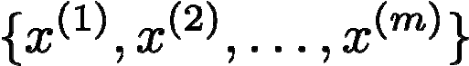
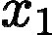

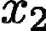





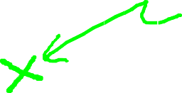




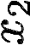





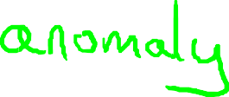


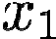
Anomaly detection example
Aircraft engine features:
= heat generated
= vibration intensity
…
Dataset:
New engine:
(vibration)
The set of data points that are considerably different than the remainder of the data
(heat)
AI/ML Professional Training Program: INNOQUEST COHORT-1
Instructor: Prof. Ahmad Raza Shahid
Notes:
Anomaly detection example in aircraft engines

Slide 102
Applications
Credit card fraud detection
Telecommunication fraud detection
Network intrusion detection
Fault detection
AI/ML Professional Training Program: INNOQUEST COHORT-1
Instructor: Prof. Ahmad Raza Shahid

Slide 103

Anomaly Detection Schemes
General Steps
Build a profile of the “normal” behavior
Profile can be patterns or summary statistics for the overall population
Use the “normal” profile to detect anomalies
Anomalies are observations whose characteristics differ significantly from the normal profile
Types of anomaly detection schemes
Graphical & Statistical-based

Slide 104
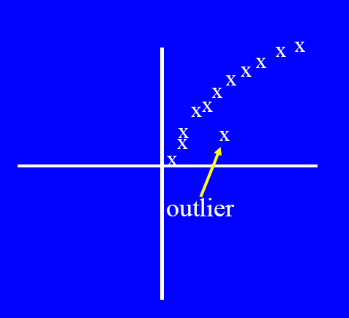
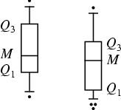
Graphical Approaches
Boxplot (1-D), Scatter plot (2-D), Spin plot (3-D)

Slide 105
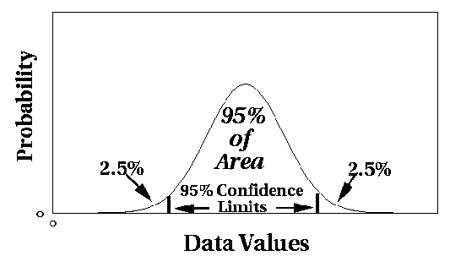
Statistical Approaches
Assume a parametric model describing the distribution of the data (e.g., normal distribution)
Apply a statistical test that depends on
Data distribution
Parameter of distribution (e.g., mean, variance)
Number of expected outliers (confidence limit)

Slide 106
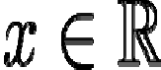
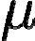
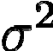
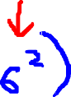


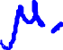





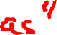
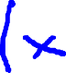
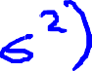


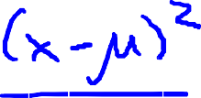

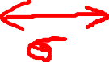
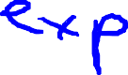

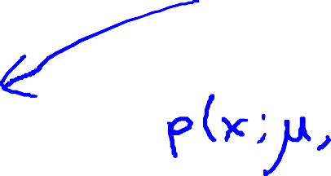
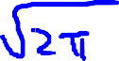






Gaussian (Normal) distribution
Say . If is a distributed Gaussian with mean
, variance .
Notes:
This is also called Normal Distribution
We will be using the Gaussian Distribution to develop an anomaly detection algorithm
Introduction

Slide 107

Gaussian (Normal) distribution

Slide 108

Gaussian (Normal) distribution

Slide 109



















Gaussian distribution example
Notes:
Gaussian distribution example
Area under the graph (red shaded area) must always equate to 1

Slide 110































Parameter estimation
Dataset:
Notes:
Parameter estimation
m might be (m - 1)
In practice, it makes very little difference
In machine learning, most people typically use (1 / m)

Slide 111

Box and whisker plot
A box and whisker plot is also known as box plot shows the five-number summary of a set of data: minimum, lower quartile, median, upper quartile, and maximum

Slide 112

Box and whisker plot

Slide 113

Box and whisker plot example

Slide 114



Slide 115
Principal Component Analysis (PCA)

Slide 116
PCA
PCA is a technique that can be used to simplify a dataset. PCA can be used for reducing dimensionality
It is a linear transformation that chooses a new coordinate system for the data set such that greatest variance by any projection of the data set comes to lie on the first axis (then called the first principal component), the second greatest variance on the second axis, and so on.
Notes:
an unsupervised linear transformation technique that is widely used across different fields, most prominently for feature extraction and dimensionality reduction.

Slide 117
PCA
An exploratory technique used to reduce the dimensionality of the data set to 2D or 3D
Can be used to:
Reduce number of dimensions in data
Find patterns in high-dimensional data
Visualize data of high dimensionality
Example applications:
Face recognition
Image compression
Gene expression analysis
Notes:
Does the data set ‘span’ the whole of d dimensional space?
For a matrix of m samples x n genes, create a new covariance matrix of size n x n.
Transform some large number of variables into a smaller number of uncorrelated variables called principal components (PCs).
developed to capture as much of the variation in data as possible

Slide 118
Motivation I: Data Compression

Slide 119



Data Compression
(inches)
Reduce data from 2D to 1D
(cm)
Notes:
You are able to reduce the dimension of the data from 2D to 1D
For example, pilot skill and pilot happiness can be reduced to pilot’s aptitude

Slide 120








Data Compression
Reduce data from 2D to 1D
(inches)
(cm)
Notes:
Generally, you can reduce x1 and x2 to z1

Slide 121






Data Compression
Reduce data from 3D to 2D
Notes:
Your are able to reduce the dimension of the data from 3D to 2D
Project the data such that they lie on a plane
Specify two axes
z1
z2
You would then be able to reduce the data’s dimension from 3D to 2D

Slide 122
Motivation II: Data Visualization

Slide 123

Data Visualization
Country | GDP (trillions of US$) | Per capita GDP (thousands of intl. $) | Human Develop-ment Index | Life expectancy | Poverty Index (Gini as percentage) | Mean household income (thousands of US$) | …
Canada | 1.577 | 39.17 | 0.908 | 80.7 | 32.6 | 67.293 | …
China | 5.878 | 7.54 | 0.687 | 73 | 46.9 | 10.22 | …
India | 1.632 | 3.41 | 0.547 | 64.7 | 36.8 | 0.735 | …
Russia | 1.48 | 19.84 | 0.755 | 65.5 | 39.9 | 0.72 | …
Singapore | 0.223 | 56.69 | 0.866 | 80 | 42.5 | 67.1 | …
USA | 14.527 | 46.86 | 0.91 | 78.3 | 40.8 | 84.3 | …
… | … | … | … | … | … | …
[resources from en.wikipedia.org]
Notes:
Given a set of data, how are able to examine the data such as this?

Slide 124

Data Visualization
Country
Canada | 1.6 | 1.2
China | 1.7 | 0.3
India | 1.6 | 0.2
Russia | 1.4 | 0.5
Singapore | 0.5 | 1.7
USA | 2 | 1.5
… | … | …
Notes:
We can use reduce the data’s dimensionality from 50D to 2D
Typically we do not know what the 2 dimensions’ meanings are
But we can make sense of out of the 2 dimensions

Slide 125


Data Visualization
Notes:
Make points look uncorrelated
US, Singapore in blue

Slide 126
PCA problem formulation

Slide 127

PCA problem formulation
Notes:
Let’s say we have the following 2D data

Slide 128







PCA problem formulation
Reduce from 2-dimension to 1-dimension: Find a direction (a vector )
onto which to project the data so as to minimize the projection error.
Reduce from n-dimension to k-dimension: Find vectors
onto which to project the data, so as to minimize the projection error.
Notes:
We can project with a diagonal line (red line)
PCA reduces the blue lines (the projection error)
Before performing PCA, perform mean normalization (mean = 0) and feature scaling
We can also project with another diagonal line (magenta)
But the projection errors are much larger
Hence PCA would choose the red line instead of this magenta line
Goal of PCA
It’s trying to find a lower dimensional surface onto which to project the data, so as to minimize this squared projection error
To minimize the square distance between each point and the location of where it gets projected.

Slide 129


PCA is not linear regression

Slide 130


PCA is not linear regression
Notes:
PCA is not linear regression
PCA is a minimization of the orthogonal distance

Slide 131
PCA algorithm

Slide 132







Data preprocessing
Training set:
Preprocessing (feature scaling/mean normalization):
Replace each with .
If different features on different scales (e.g., size of house,
number of bedrooms), scale features to have comparable range of values.
Notes:
Data pre-processing step
You must always do this before doing PCA

Slide 133



PCA algorithm
Reduce data from 2D to 1D
Reduce data from 3D to 2D
Notes:
PCA intuition
You need to compute the vector or vectors
Left graph: compute vector z(1)
Right graph: compute vector z(1) and z(2)

Slide 134





PCA algorithm
Reduce data from -dimensions to -dimensions
Compute “covariance matrix”:
Compute “eigenvectors” of matrix :
[U,S,V] = svd(Sigma);
Notes:
Procedure
You can use eig (eigen) or svd (singular value decomposition) but the later is more stable
You can use any library in other languages that does singular value decomposition
You will get 3 matrices: U, S and V
But we only need matrix U where we manipulate to get z that is a k x 1 vector

Slide 135
PCA algorithm
[U,S,V] = svd(Sigma)
U (Left Singular Vectors):
U is an orthogonal matrix containing the left singular vectors of Σ.
Each column of U is a left singular vector.
These vectors represent the directions of maximum variance in the original data space.
2. S (Singular Values):
S is a diagonal matrix containing the singular values of Σ.
The singular values are non-negative and sorted in descending order.
They provide the scale or importance of each corresponding singular vector.
3. V (Right Singular Vectors):
V is an orthogonal matrix containing the right singular vectors of Σ.
Each column of V is a right singular vector.
These vectors represent the directions of maximum variance in the feature space (in the context of Principal Component Analysis, PCA).
Notes:
SVD is a way to decompose a matrix into components that reveal the intrinsic structure of the data. U and V provide the directions (principal components in PCA), and S provides the magnitude (explained variance in PCA).

Slide 136


PCA algorithm
From , we get:
[U,S,V] = svd(Sigma)

Slide 137
Recommendation Systems

Slide 138
What is recommendation system
A recommendation system is an algorithm designed to suggest items to users based on their preferences or behavior.
Examples :
Netflix recommending movies.
Amazon suggesting products.

Slide 139

Why recommendation?
The goal of recommender systems is…
To help people discover new content

Slide 140

Why recommendation?
The goal of recommender systems is…
To help us find the content we were already looking for
Are these recommendations good or bad?

Slide 141


Why recommendation?
The goal of recommender systems is…
To discover which things go together

Slide 142

Why recommendation?
The goal of recommender systems is…
To identify things that we like

Slide 143

Recommending things to people
Suppose we want to build a movie recommender
e.g. which of these films will I rate highest?

Slide 144



Recommending things to people
We already have a few tools in our “supervised learning” toolbox that may help us

Slide 145






Example: Predicting movie ratings
User rates movies using one to five stars
Movie | Alice (1) | Bob (2) | Carol (3) | Dave (4)
Love at last
Romance forever
Cute puppies of love
Nonstop car chases
Swords vs. karate
= no. users
= no. movies
= 1 if user has rated movie
= rating given by user to movie (defined only if
)

Slide 146
Types of recommendation system
1. Content-Based Filtering
Recommend items similar to those a user liked in the past.
Relies on user-item similarity.
Requires detailed item attributes.
Example: "You liked Inception, so you might like Interstellar."
2. Collaborative Filtering
Uses the preferences of other users.
Works on "people who liked this also liked..." principle.
User-Based: Finds similar users and recommends their liked items.
Item-Based: Finds similar items and recommends them to the user.

Slide 147
Collaborative filtering

Slide 148
Defining similarity between users & items
Q: How can we measure the similarity
between two users?
A: In terms of the items they purchased!
Q: How can we measure the similarity between two items?
A: In terms of the users who purchased them!

Slide 149


Defining similarity between users & items
e.g.: Amazon

Slide 150


Definitions
Definitions
= set of items purchased by user u
= set of users who purchased item i

Slide 151





Definitions
items
Or equivalently…
users
= binary representation items purchased by u
= binary representation of users who purchased i

Slide 152



0. Euclidean distance
Euclidean distance:
e.g. between two items i,j (similarly defined between two users)
A
B

Slide 153
0. Euclidean distance
Euclidean distance:
e.g.: U_1 = {1,4,8,9,11,23,25,34}
U_2 = {1,4,6,8,9,11,23,25,34,35,38}
U_3 = {4}
U_4 = {5}
Problem: favors small sets, even if they have few elements in common

Slide 154





1. Jaccard similarity
→ Maximum of 1 if the two
users purchased exactly the same set of items
(or if two items were purchased by the same set of users)
→ Minimum of 0 if the two users purchased completely disjoint sets of items
(or if the two items were purchased by completely disjoint sets of users)
A
B

Slide 155









2. Cosine similarity
(theta = 0) → A and B point in exactly the same direction
(theta = 180) → A and B point in opposite directions (won’t actually happen for 0/1 vectors)
(vector representation of users who purchased harry potter)
(theta = 90) → A and B are orthogonal

Slide 156


2. Cosine similarity
Why cosine?
Unlike Jaccard, works for arbitrary vectors
E.g. what if we have opinions in addition to purchases?
bought and liked
didn’t buy
bought and hated

Slide 157


2. Cosine similarity
E.g. our previous example, now with “thumbs-up/thumbs-down” ratings
(theta = 0) → Rated by the same users, and they all agree
(theta = 180) → Rated by the same users, but they completely disagree about it
(vector representation of users’ ratings of Harry Potter)
(theta = 90) → Rated by different sets of users

Slide 158


4. Pearson correlation
What if we have numerical ratings (rather than just thumbs-up/down)?
bought and liked
didn’t buy
bought and hated

Slide 159
4. Pearson correlation
What if we have numerical ratings (rather than just thumbs-up/down)?
We wouldn’t want 1-star ratings to be parallel to 5-
star ratings
So we can subtract the average – values are then
negative for below-average ratings and positive
for above-average ratings
items rated by both users
average rating by user v

Slide 160

4. Pearson correlation
Compare to the cosine similarity:
Pearson similarity (between users):
items rated by both users average rating by user v
Cosine similarity (between users):

Slide 161




Collaborative filtering in practice
How did Amazon generate their ground-truth data?
Given a product:
Let be the set of users
who viewed it
Rank products according to:
(or cosine/pearson)
.86
.84
.82
.79
…
Linden, Smith, & York (2003)

Slide 162
Collaborative filtering in practice
Note: (surprisingly) that we built something pretty useful out of nothing but rating data – we didn’t look at any features of the products whatsoever

Slide 163

Problem motivation
Movie | Alice (1) | Bob (2) | Carol (3) | Dave (4) | (romance) | (action)
Love at last | 5 | 5 | 0 | 0 | 0.9 | 0
Romance forever | 5 | ? | ? | 0 | 1.0 | 0.01
Cute puppies of love | ? | 4 | 0 | ? | 0.99 | 0
Nonstop car chases | 0 | 0 | 5 | 4 | 0.1 | 1.0
Swords vs. karate | 0 | 0 | 5 | ? | 0 | 0.9
Notes:
Here we will be learning about “Feature Learning”
Feature Learning: learning what features to use
Problem motivation
It is inefficient and difficult to ask someone to watch each movie and inform us how romantic or action-packed the movie is

Slide 164
Content-based recommendations

Slide 165





Content-based recommender systems
Movie | Alice (1) | Bob (2) | Carol (3) | Dave (4) | (romance) | (action)
Love at last | 5 | 5 | 0 | 0 | 0.9 | 0
Romance forever | 5 | ? | ? | 0 | 1.0 | 0.01
Cute puppies of love | ? | 4 | 0 | ? | 0.99 | 0
Nonstop car chases | 0 | 0 | 5 | 4 | 0.1 | 1.0
Swords vs. karate | 0 | 0 | 5 | ? | 0 | 0.9
For each user , learn a parameter . Predict user as rating movie with stars.
Notes:
Add dots

Slide 166







Problem formulation
if user has rated movie (0 otherwise)
rating by user on movie (if defined)
= parameter vector for user
= feature vector for movie
For user , movie , predicted rating:
= no. of movies rated by user
To learn :
Notes:
If we minimize the following function, we get the parameters to predict

Slide 167




Optimization objective
To learn (parameter for user ):
To learn :

Slide 168


Optimization algorithm
Gradient descent update:
Notes:
We can use other minimization algorithms (other than gradient descent)

Slide 169
Reference
Machine Learning with PyTorch and Scikit-Learn (Sebastian Raschka, Yuxi Liu, Vahid Mirjalili)
Andrew ng

Slide 170
Thank you

